Slide 1
CPU scheduling - 2

Slide 2
Preemptive Priority scheduling
In preemptive priority scheduling algorithm, every time a process with higher priority arrives in the waiting queue, the CPU cycle is shifted to the process with the highest priority.
This is preemptive because a process that's already being executed can be stopped to execute a process with higher priority.
Once all the jobs get available in the ready queue, the algorithm will behave as non-preemptive priority scheduling, which means the job scheduled will run till the completion and no preemption will be done.

Slide 3
Example
There are 7 processes P1, P2, P3, P4, P5, P6 and P7 given. Their respective priorities, Arrival Times and Burst times are given in the table below.
Process Id | Priority | Arrival Time | Burst Time
1 | 2 | 0 | 1
2 | 6 | 1 | 7
3 | 3 | 2 | 3
4 | 5 | 3 | 6
5 | 4 | 4 | 5
6 | 10 | 5 | 15
7 | 9 | 15 | 8

Slide 4
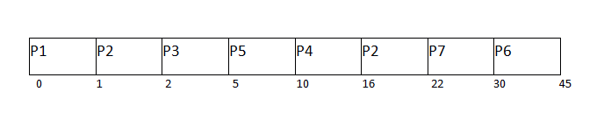
Solution – Gantt chart
Turnaround Time = Completion Time - Arrival Time
Waiting Time = Turn Around Time - Burst Time
Process Id | Priority | Arrival Time | Burst Time | Completion Time | Turn around Time | Waiting Time
1 | 2 | 0 | 1 | 1 | 1 | 0
2 | 6 | 1 | 7 | 22 | 21 | 14
3 | 3 | 2 | 3 | 5 | 3 | 0
4 | 5 | 3 | 6 | 16 | 13 | 7
5 | 4 | 4 | 5 | 10 | 6 | 1
6 | 10 | 5 | 15 | 45 | 40 | 25
7 | 9 | 6 | 8 | 30 | 24 | 16
Avg Waiting Time = (0+14+0+7+1+25+16)/7 = 63/7 = 9 units

Slide 5
Solution - Steps
At time 0, P1 arrives with the burst time of 1 units and priority 2. Since no other process is available hence this will be scheduled till next job arrives or its completion (whichever is lesser).
At time 1, P2 arrives. P1 has completed its execution and no other process is available at this time hence the Operating system has to schedule it regardless of the priority assigned to it.
The Next process P3 arrives at time unit 2, the priority of P3 is higher to P2. Hence the execution of P2 will be stopped and P3 will be scheduled on the CPU.
During the execution of P3, three more processes P4, P5 and P6 becomes available. Since, all these three have the priority lower to the process in execution so PS can't preempt the process. P3 will complete its execution and then P5 will be scheduled with the priority highest among the available processes
Meanwhile the execution of P5, all the processes got available in the ready queue. At this point, the algorithm will start behaving as Non Preemptive Priority Scheduling. Hence now, once all the processes get available in the ready queue, the OS just took the process with the highest priority and execute that process till completion. In this case, P4 will be scheduled and will be executed till the completion.
Since P4 is completed, the other process with the highest priority available in the ready queue is P2. Hence P2 will be scheduled next.
P2 is given the CPU till the completion. Since its remaining burst time is 6 units hence P7 will be scheduled after this.
The only remaining process is P6 with the least priority, the Operating System has no choice unless of executing it. This will be executed at the last.

Slide 6
Round-Robin Scheduling
Round Robin CPU Scheduling is the most important CPU Scheduling Algorithm which is ever used in the history of CPU Scheduling Algorithms.
Round Robin CPU Scheduling uses Time Quantum (TQ).
The Time Quantum is something which is removed from the Burst Time and lets the chunk of process to be completed.
Time Sharing is the main emphasis of the algorithm. Each step of this algorithm is carried out cyclically.
The system defines a specific time slice, known as a time quantum.

Slide 7
Round-Robin Scheduling - Steps
First, the processes which are eligible to enter the ready queue enter the ready queue.
After entering the first process in Ready Queue is executed for a Time Quantum chunk of time.
After execution is complete, the process is removed from the ready queue. Even now the process requires some time to complete its execution, then the process is added to Ready Queue.
The Ready Queue does not hold processes which already present in the Ready Queue.
The Ready Queue is designed in such a manner that it does not hold non unique processes. By holding same processes Redundancy of the processes increases.
After, the process execution is complete, the Ready Queue does not take the completed process for holding.

Slide 8
RR –Time Quantum
In the Round Robin scheduling algorithm, as the time quantum decreases context switching increases.
The increase in time quantum value results in time starvation which may put many processes on hold.
So, time quantum should neither be large nor be small.
If time quantum becomes infinity, Round Robin scheduling algorithm gradually become FCFS scheduling algorithm.

Slide 9
Advantages & Disadvantages of RR of RR
The Advantages of Round Robin CPU Scheduling are:
A fair amount of CPU is allocated to each job.
Because it doesn't depend on the burst time, it can truly be implemented in the system.
It is not affected by the convoy effect or the starvation problem as occurred in First Come First Serve CPU Scheduling Algorithm.
The Disadvantages of Round Robin CPU Scheduling are:
Low Operating System slicing times will result in decreased CPU output.
Round Robin CPU Scheduling approach takes longer to swap contexts.
Time quantum has a significant impact on its performance.
The procedures cannot have priorities established.

Slide 10
Example – RR Assume Time Quantum TQ = 5
Process ID Arrival Time Burst Time
_ _ _ _ _ _ _ _ _ _ _ _ _ _ _ _ _ _ _
P 1 0 7
P 2 1 4
P 3 2 15
P 4 3 11
P 5 4 20
P 6 4 9

Slide 11
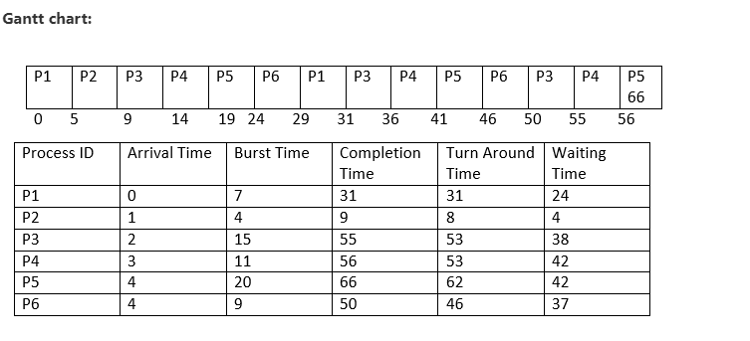
Solution – Gantt Chart

Slide 12
Solution
Average Completion Time
Average Completion Time = ( 31 +9 + 55 +56 +66 + 50 ) / 6
Average Completion Time = 267 / 6
Average Completion Time = 44.5
Average Waiting Time
Average Waiting Time = ( 5 + 26 + 5 + 42 + 42 + 37 ) / 6
Average Waiting Time = 157 / 6
Average Waiting Time = 26.16667
Average Turn Around Time
Average Turn Around Time = ( 31 + 8 + 53 + 53 + 62 + 46 ) / 6
Average Turn Around Time = 253 / 6
Average Turn Around Time = 42.16667

Slide 13
Exercise -RR
In the following example, there are six processes named as P1, P2, P3, P4, P5 and P6. Their arrival time and burst time are given below in the table. The time quantum of the system is 4 units.
Process ID | Arrival Time | Burst Time
1 | 0 | 5
2 | 1 | 6
3 | 2 | 3
4 | 3 | 1
5 | 4 | 5
6 | 6 | 4

Slide 14
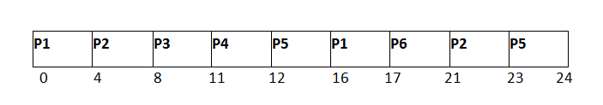
Solution
Process ID | Arrival Time | Burst Time | Completion Time | Turn Around Time | Waiting Time
1 | 0 | 5 | 17 | 17 | 12
2 | 1 | 6 | 23 | 22 | 16
3 | 2 | 3 | 11 | 9 | 6
4 | 3 | 1 | 12 | 9 | 8
5 | 4 | 5 | 24 | 20 | 15
6 | 6 | 4 | 21 | 15 | 11
Avg Waiting Time = (12+16+6+8+15+11)/6 = 76/6 units

Slide 15
Context switching in scheduling

Slide 16
Context Switch in SRTF
Consider three CPU-intensive processes, which require 10, 20 and 30 time units and arrive at times 0, 2 and 6, respectively. How many context switches are needed if the operating system implements a shortest remaining time first scheduling algorithm?
Do not count the context switches at time zero and at the end. Explanation:
Let three process be P0, P1 and P2 with arrival times 0, 2 and 6 respectively and CPU burst times 10, 20 and 30 respectively. At time 0, P0 is the only available process so it runs. At time 2, P1 arrives, but P0 has the shortest remaining time, so it continues. At time 6, P2 arrives, but P0 has the shortest remaining time, so it continues. At time 10, P1 is scheduled as it is the shortest remaining time process. At time 30, P2 is scheduled.
Hence, only two context switches are needed. P0 to P1 and P1 to P2.

Slide 17
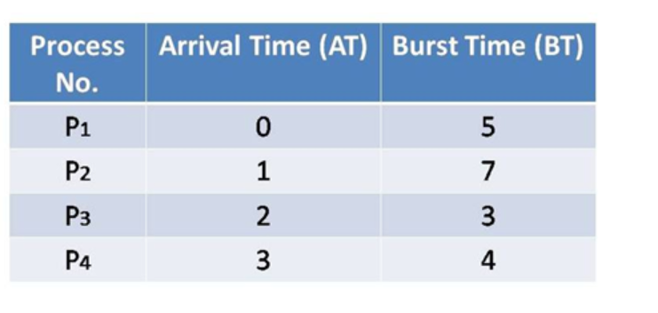
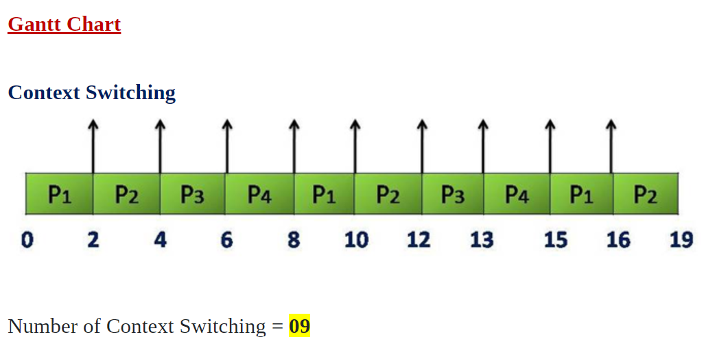
Context Switch in RR
Time Quantum = 2

